Slide 1
Classical Civilizations
Unit 2

Slide 2
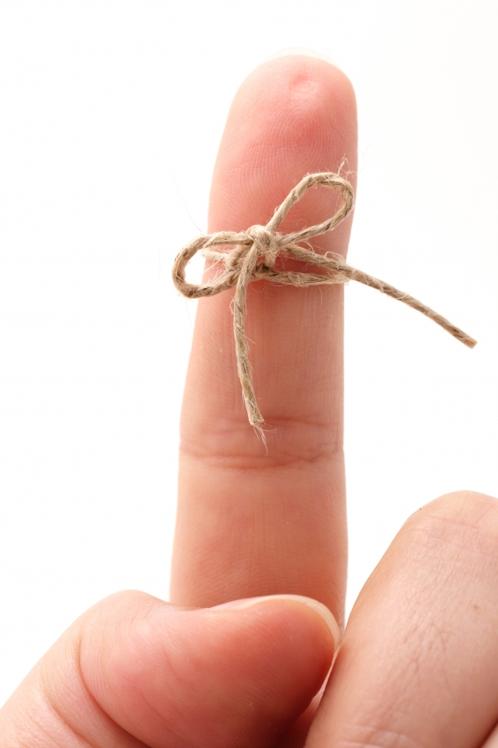
Civilization
Complex cultures characterized by cities, specialized workers, complex institutions, record keeping and advanced technology

Slide 3
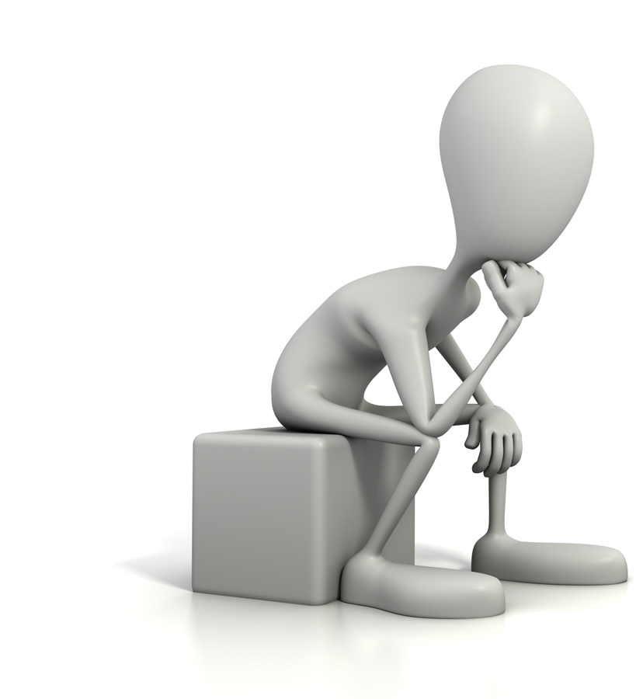
So what is a Classical Civilization then?

Slide 4
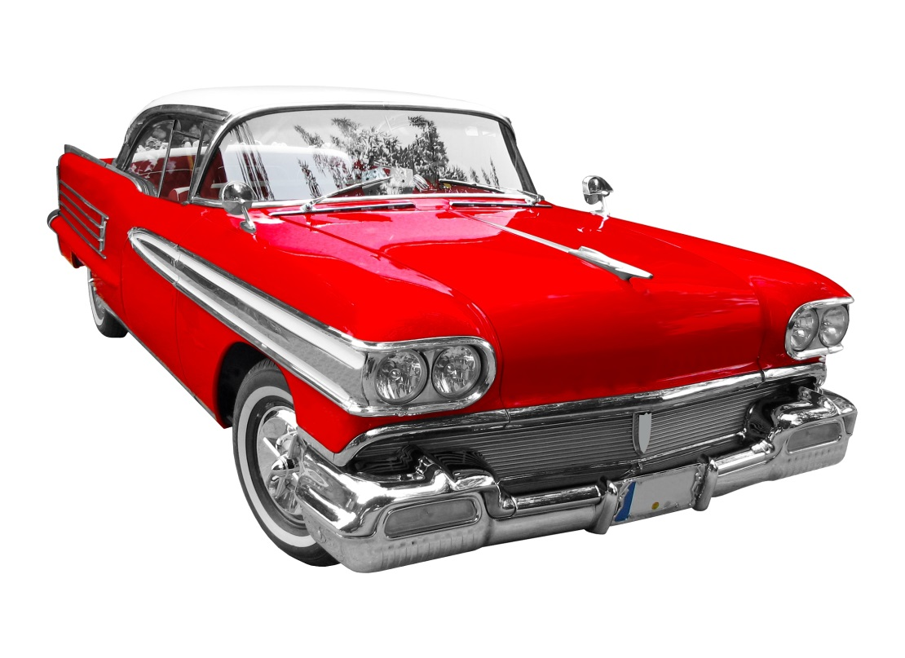
What do people mean when they say something is a classic?
List some examples of classic movies, books, or cars.

Slide 5
Objective
Learn the key characteristics of classical civilizations.
These are civilizations whose legacies – cultural, political, or otherwise – have endured since their collapse.

Slide 6
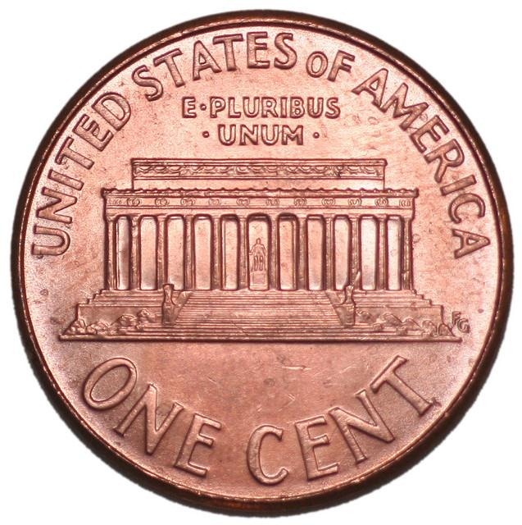
Notes:
What do they see? (The building they see is the Lincoln Memorial in Washington, DC and the words they see are: E PLURIBUS UNUM which is Latin for “Out of many, one.”) Tell students that the building is designed like an ancient Greek temple and is an example of how the classical architecture of ancient Greece influences our society today. The words are written in Latin, the language of the ancient Roman Empire and the basis for many of our English words today. Ask students why they think those words in Latin were put on the back of a penny. Emphasize to students that even on a penny, one can see how Greece and Rome continue to influence our lives today.

Slide 7
Empire
Political unit having an extensive territory or comprising a number of territories or nations and ruled by a single supreme authority

Slide 8
5 Classical Civilizations
Middle America
Eastern Civilizations
Western Civilizations

Slide 9
EMPIRES
GREECE: 750BCE – 323 BCE
ROME: 500 BCE- 476 CE
INDIA
Mauryan: 321BCE – 185 BCE
Gupta: 320 CE – 550CE
CHINA
Zhou: 1046 BCE – 256 BCE
Quin: 221BCE – 206 BCE
HAN: 206 BCE – 220 CE
MIDDLE AMERICA
Olmec 1200BCE – 400 BCE
Mayan 250 CE – 900 CE

Slide 10
Timeline
Greece
ROME
India
CHINA
M. America

