Slide 1
1980s-1990s
OVERVIEW

Slide 2
End of the 70s Beginning of the 80s
Carter, Regan, H.W. Bush, Clinton

Slide 3
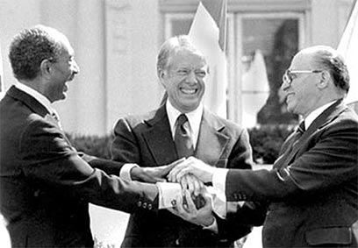
Camp David Accords
One of the greatest achievements of Carter was in his foreign policy.
Carter negotiated a peace agreement between Israel and Egypt that was known as the Camp David Accords, signed in September 1978.
Carter’s work with foreign countries eventually earned him the Nobel Peace Prize in 2002.

Slide 4
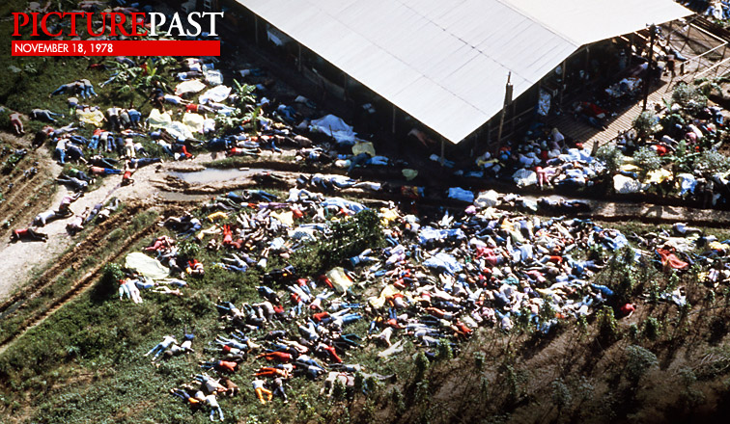
Jonestown Massacre
Americans were shocked in 1978 when The Peoples Temple, a religious cult, had a mass suicide that left nearly 1,000 people dead

Slide 5
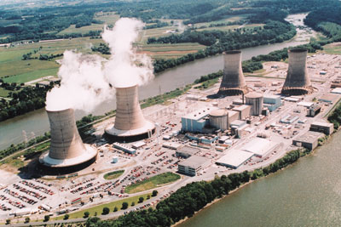
Three Mile Island disaster
The Three Mile Island disaster is when a nuclear power facility in Pennsylvania had a core meltdown.
The incident occurred in March of 1979 and was the worst nuclear power accident in U.S. history
The meltdown led to radioactive gases being leaked into the air.

Slide 6
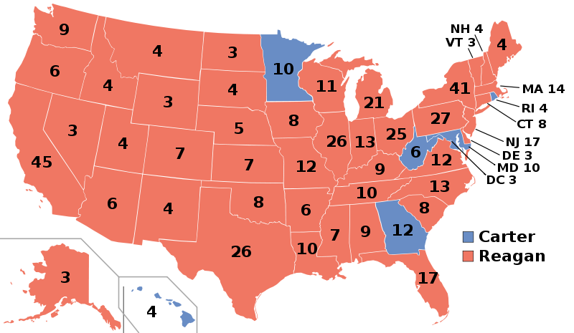
Election of 1980

Slide 7
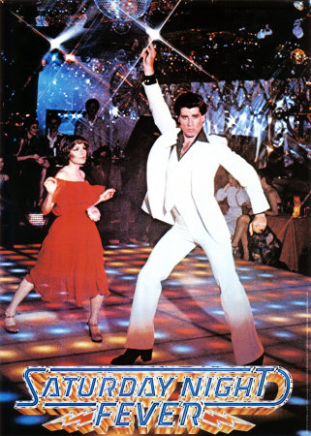
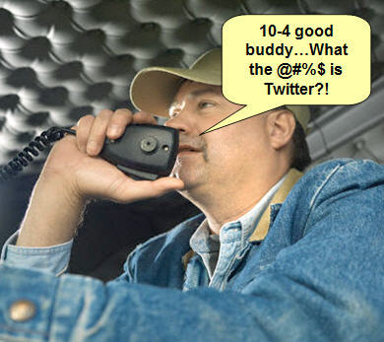
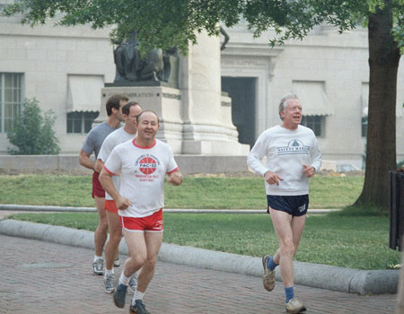
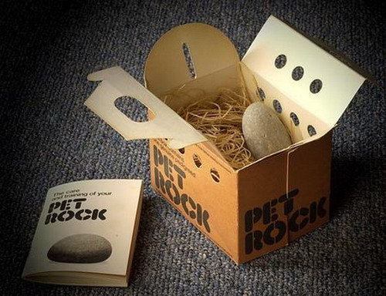
Pop Culture of the 70s
CB Radios
Disco
Pet Rocks
Bellbottoms
Jogging

Slide 8
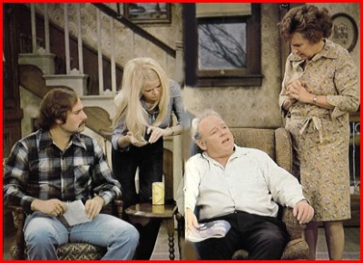
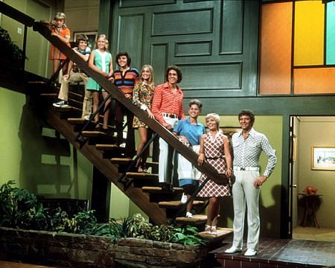
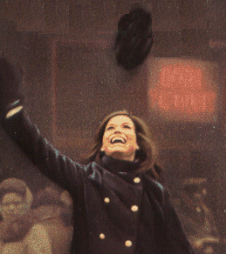
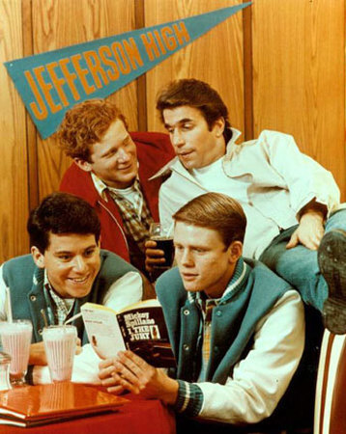
Pop Culture of the 70s
Top
TV
Shows
All in the Family
The Brady Bunch
Happy Days
Mary Tyler Moore Show

Slide 9
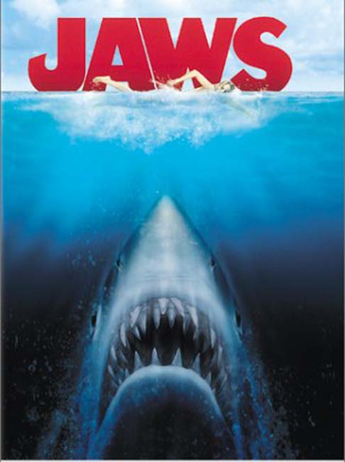
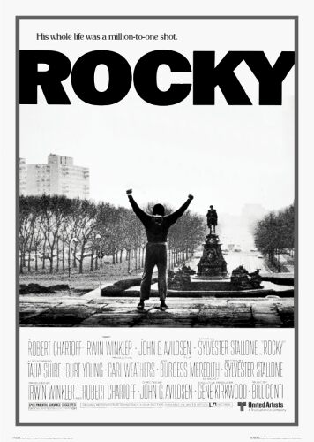
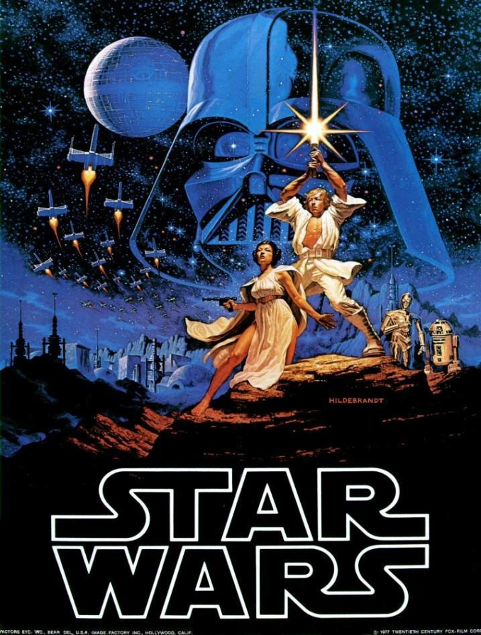
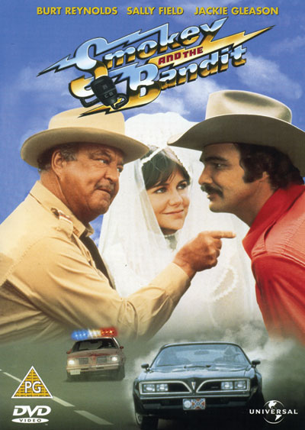
Pop Culture of the 70s
Top in
Movies

Slide 10
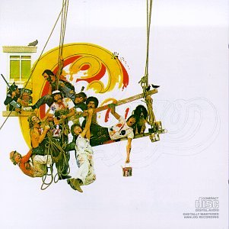
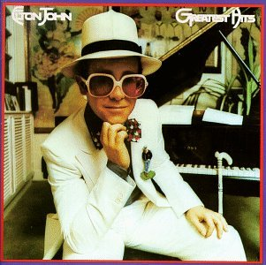
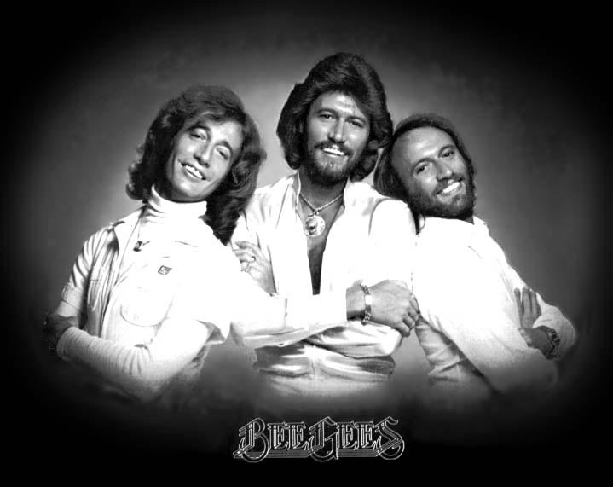
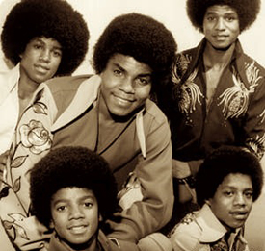
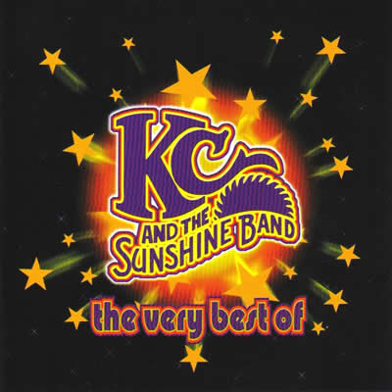
Pop Culture of the 70s
Top in
Music

Slide 11
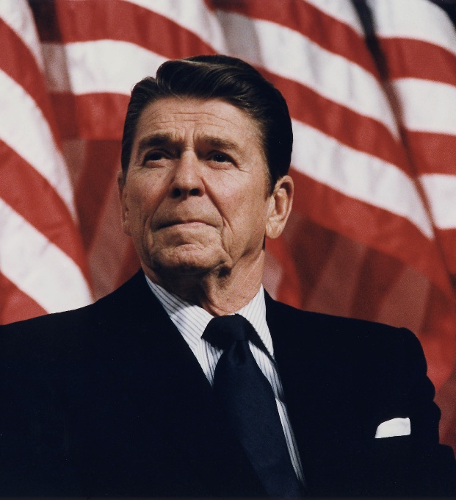
Ronald Regan
January 20, 1981 – January 20, 1989

Slide 12
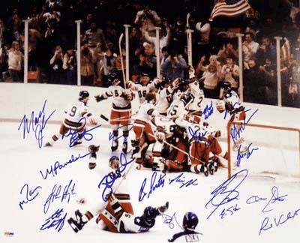
The Miracle on Ice
The U.S. victory over Russia in the 1980 winter Olympics restored American pride after a difficult decade for the nation

Slide 13
Rise of Conservatism
Conservative
Republican
Right
Capitalism
Fiscally: Limited government spending, lower taxes
Socially: Strict enforcement of laws, moral values
Liberal
Democrat
Left
Socialism
Fiscally: Government programs to help poor, elderly, children
Socially: Protection of personal freedoms and liberties
Conservative ideas gained support for two main reasons
Some Americans believed that the government’s role in the economy was leading the U.S. towards communism
Many Americans saw the Cold War as a battle between good and evil

Slide 14
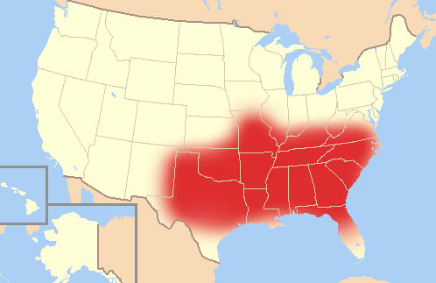
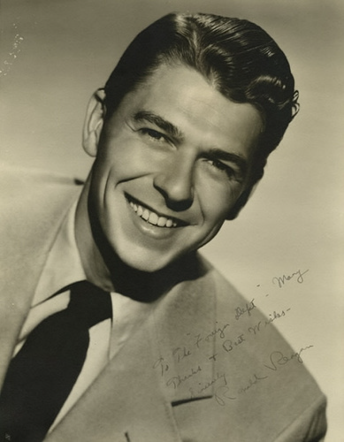
Rise of Conservatism
Conservatism grew throughout a region of the nation known as the Sunbelt. Because most people in this region are religious, the area was known as the Bible Belt
The leading voice of the conservative movement became a former actor named Ronald Reagan

Slide 15
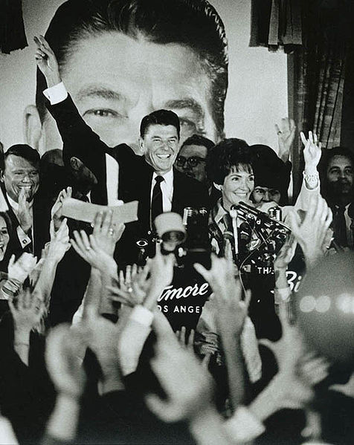
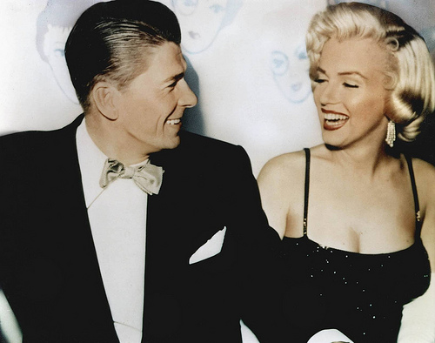
Reagan rises to power
Ronald Reagan had gained popularity as a Hollywood movie star before becoming Governor of California in 1967
Left, Ronald Reagan with Marilyn Monroe; above, Reagan following his victory in California governors race

Slide 16
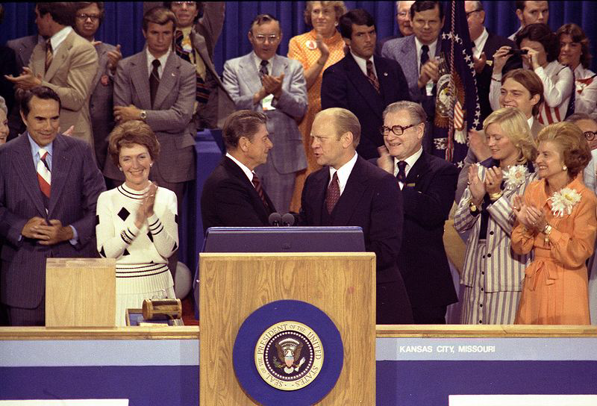
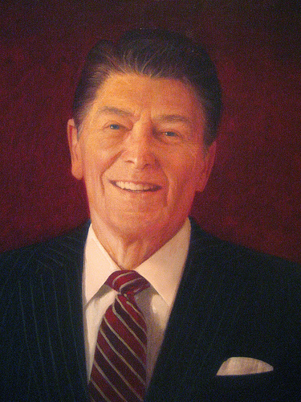
Ronald Reagan takes over
People were upset with Carter over the economy, Iran hostage crisis
Because people saw Reagan as a symbol of hope and pride, Reagan defeated Carter in a landslide

Slide 17
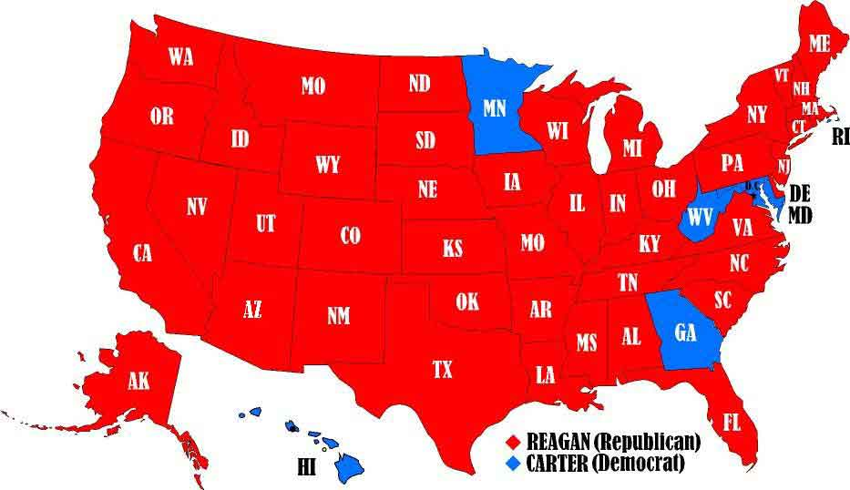
Election of 1980

Slide 18
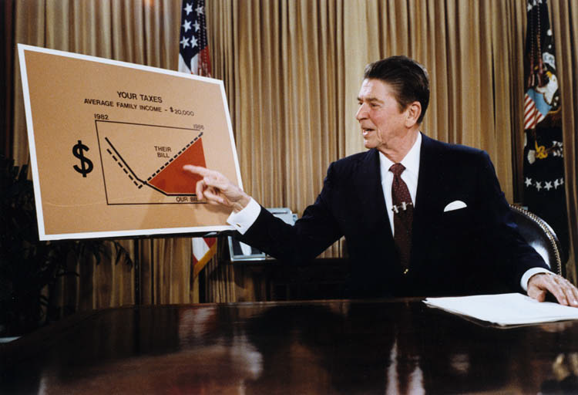
Reagonomics
Reagan brought to the presidency new economic policies, advocating a limited government and economic laissez-faire philosophy. Reagan believed that the government should not regulate big businesses that would keep them from prospering.

Slide 19
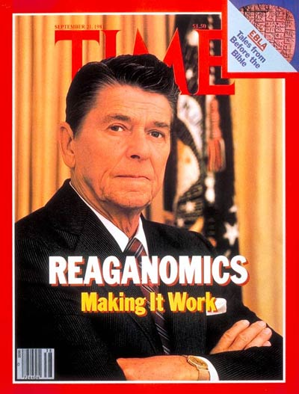
Reagonomics
Reaganomics believed in:
Cutting taxes would help businesses use money they didn’t have to pay to the government to make new investments
Increasing the growth of the business and create new jobs
More goods for consumers, lower prices, while consumers would have more money to spend.

Slide 20
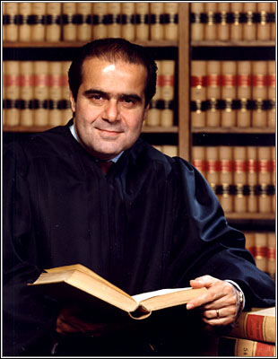
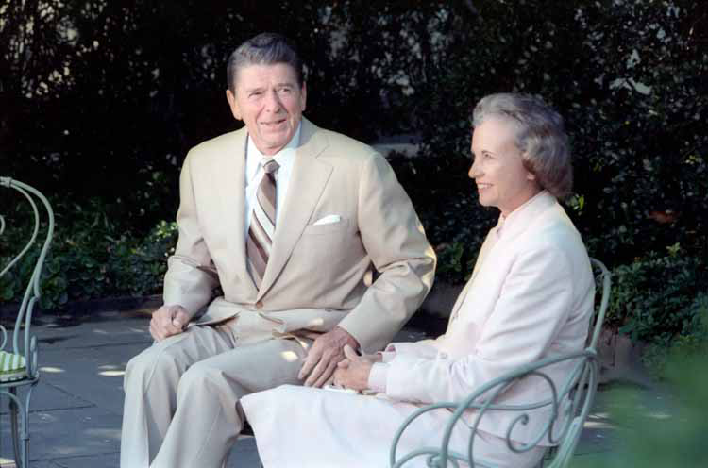
Reagan Reshapes Court
President Reagan was able to sway the U.S. Supreme Court to the right with the appointments of two conservatives – Antonin Scalia and Sandra Day O’Connor
O’Connor was the first woman chosen for the Supreme Court

Slide 21
Reagan Doctrine
Reagan believed the U.S. should support groups that were fighting to overthrow Communists governments. This policy was called the Reagan Doctrine.
Two places Reagan implemented this policy were Afghanistan in Southwest Asia and Nicaragua in Central America.
In Afghanistan, Reagan sent aid Afghani freedom fighters known as the Mujahedeen, who were fighting off a Soviet invasion.
Reagan’s involvement in Nicaragua led to a scandal that came to be known as the Iran-Contra scandal.

Slide 22
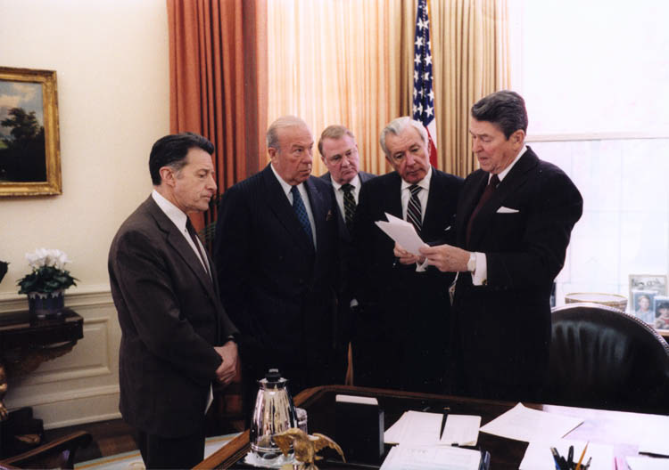
Iran-Contra Scandal
The Iran-Contra affair was a scandal during Reagan’s presidency over an arms-for-hostages deal with Iran in exchange funds for Nicaraguan rebels known as the Contras
Members of the Reagan administration secretly arranged for the illegal sale of arms to Iran in exchange for hostages
The money was then illegally funneled to support an attempted over-throw of Nicaragua's communist government

Slide 23
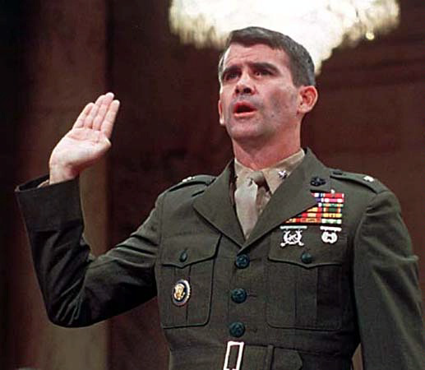
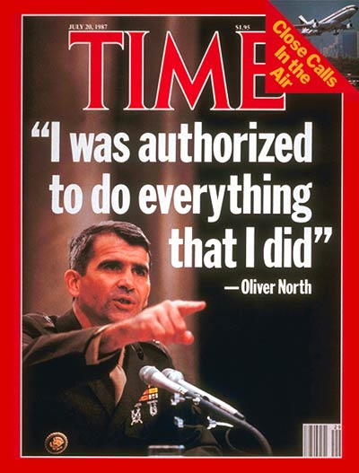
Iran-Contra Scandal
The key figure in the Iran-Contra scandal was a military aide to the National Security Council, Lieutenant Colonel Oliver North
Democrats called for an investigation and wanted to find out if President Reagan knew of the illegal activities, but no evidence implicating Reagan was ever found

Slide 24
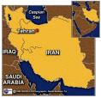
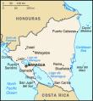
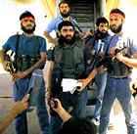
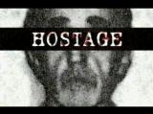
Iran-Contra Scandal
Arms
Iran
Money
Contras
=
$$$
Iran
Nicaragua
scandal that erupted after the Reagan administration sold weapons to Iran in hopes of freeing American hostages in Lebanon; money from the arms sales was used to aid the Contras (anti-Communist insurgents) in Nicaragua, even though Congress had prohibited this assistance. Talk of Reagan's impeachment ended when presidential aides took the blame for the illegal activity.
Hezbollah
No more hostages

Slide 25
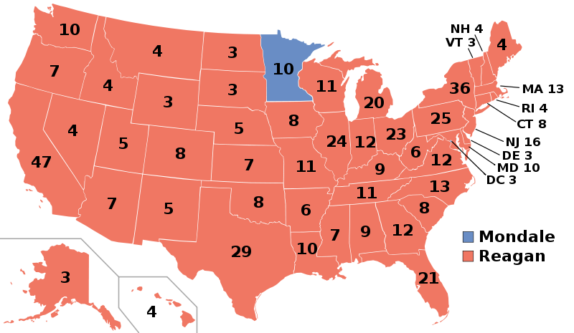
Reagan wins re-election
Reagan’s win in 1984 was the largest landslide in U.S. history

Slide 26
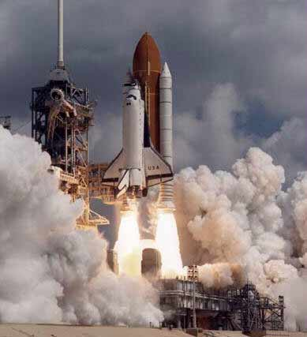
Space Shuttle launched
The United States launched the first space shuttle on April 12, 1981
The space shuttle Columbia was the first of over 100 shuttle missions flown

Slide 27
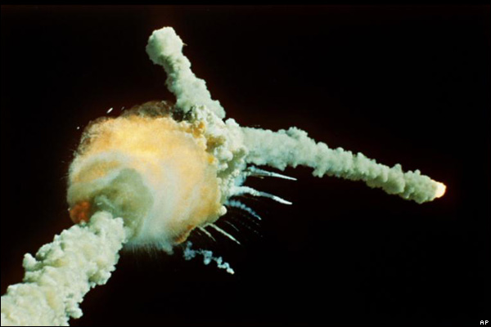
Challenger Disaster
Disaster hit the program on January 20, 1986 when the shuttle Challenger exploded shortly after takeoff
The crash killed the entire seven member crew, including teacher Christa McAuliffe

Slide 28
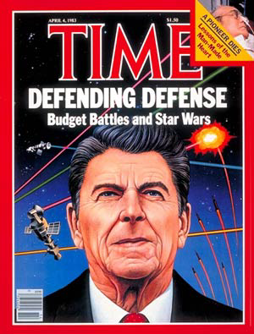
Reagan and the Cold War
President Reagan abandoned the belief in détente. He viewed the Soviet Union as evil and believed that the U.S. should not negotiate with the Russians
Reagan believed the U.S. had to be strong militarily to deal with the Soviet Union. He began a huge military buildup called Star Wars.
The Star Wars program was a defense system that would shoot Soviet missiles out of the sky in space before they reached the United States.

Slide 29
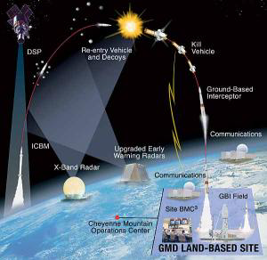

Slide 30
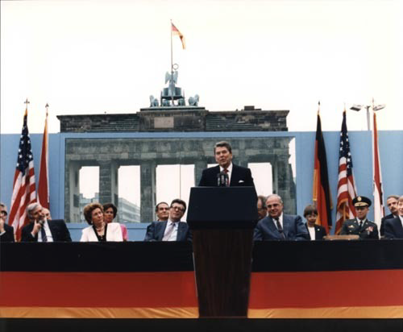
Reagan and the Cold War
In a speech at the Brandenburg Gate by the Berlin Wall on June 12, 1987, Reagan challenged Soviet leader Mikhail Gorbachev to “tear down this wall”.

Slide 31
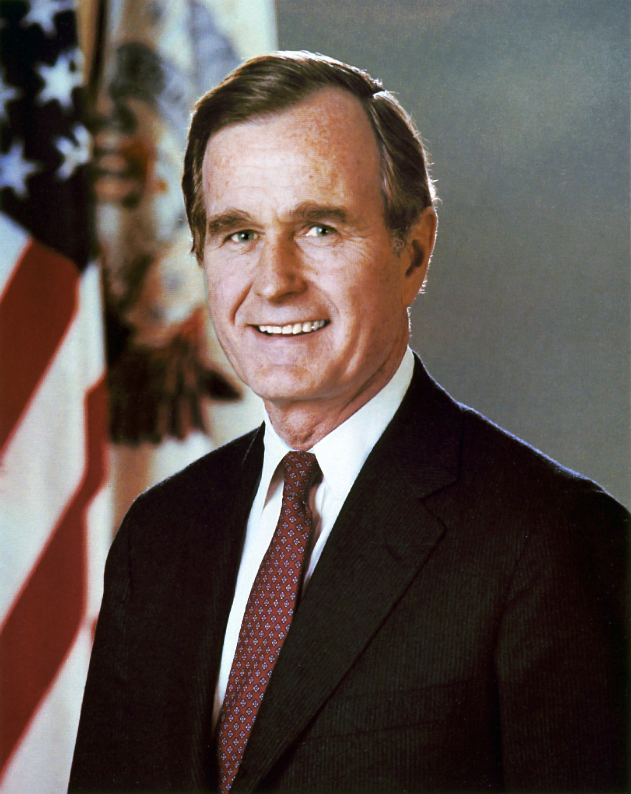
George H.W. Bush
January 20, 1989 – January 20, 1993

Slide 32
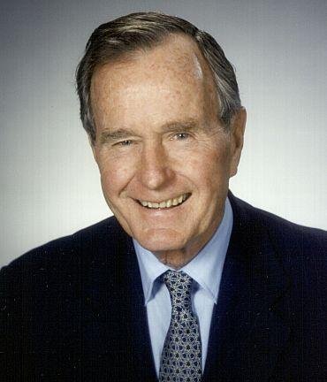
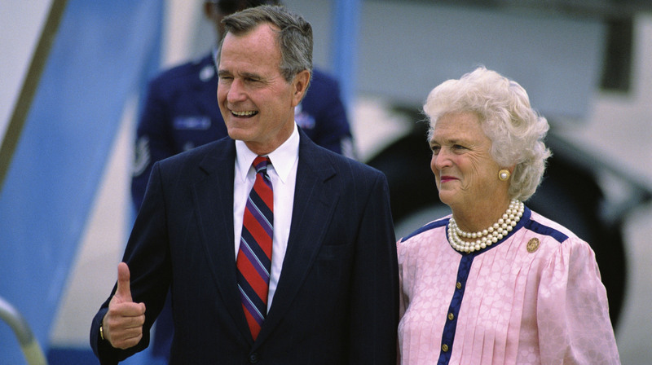
Bush takes over
In the Election of 1988, most people saw Reagan’s vice-president – George Bush – as a solid choice to continue the Reagan policies
Democrats nominated Massachusetts Governor Michael Dukakis, who promised more programs to help minorities and the poor
Bush made a pledge to the American people when he said “read my lips, no new taxes.”
Most saw Dukakis as too liberal, leading to a landslide election victory by Bush

Slide 33
Election of 1988
George Bush
Michael Dukakis

Slide 34
Exxon Valdez disaster
In March of 1989, the Exxon Valdez ran aground at Prince William Sound in Alaska. The result was an oil spill of 10.8 million gallons that was the nation’s worst environmental disaster in it’s history to date.

Slide 35
Tiananmen Square Massacre
In 1989, Chinese students held protests for democracy in Tiananmen Square, the town center of Beijing. Hundreds were executed and thousands more were either jailed or exiled. The U.S. responded by placing trade sanctions on China.

Slide 36
Fall of the Berlin Wall
With democratic ideas spreading throughout Eastern Europe, change came quickly. In November of 1989, the Berlin Wall gates were opened. East Berliners came streaming through as free people for the first time in 40 years. Within days, the wall was leveled.

Slide 37
End of the Cold War
Within a year after the fall of the Berlin Wall, Germany – a country divided the previous 40 years – was reunited.
While Germany was reuniting as a democratic country, by 1991 the Soviet Union was beginning to break apart.
In December of 1991, Gorbachev -- now a leader of a government that no longer existed -- announced the end of the Soviet Union. The Cold War was over.

Slide 38
Pop Culture of the 80s
Original Nike’s
Valley Girl Look
Pac-Man
Chiai Pet
Jogging

Slide 39
Pop Culture of the 80s
The A-Team
The Cosby Show
Top TV
Shows
Married with Children
Dallas

Slide 40
Pop Culture of the 80s
Top in
Movies

Slide 41
Pop Culture of the 80s
Top in
Music

Slide 42
Crisis in the Middle East
In 1990, Iraqi dictator Saddam Hussein invaded Kuwait, wanting to control of the oil-rich country. Many believed that this was Iraq’s first step to take control of Saudi Arabia.

Slide 43
Crisis in the Middle East
The U.S. along with other United Nations members formed a coalition to stop Hussein. The U.N. set a deadline for Iraq to withdraw or face the use of force. Hussein refused.

Slide 44
The Persian Gulf War (1991) Desert Storm
After Iraq invaded Kuwait, the US invaded Iraq to liberate Kuwait; Iraq set Kuwait's oil fields on fire so the Americans couldn't gain the oil; this conflict caused the US to set military bases in Saudi Arabia & Kuwait; also called Operation: Desert Storm Jan. 16th 1991

Slide 45
The Persian Gulf War
Iraqi Dictator Saddam Hussein
President George Bush
Gen. Colin Powell
Gen. Norman Schwarzkopf

Slide 46
The Persian Gulf War
After six weeks of air strikes, the ground war began.

Slide 47
The Persian Gulf War
After only 100 hours of fighting, President Bush declared victory. Iraq accepted the cease-fire terms and Kuwait was liberated.

Slide 48
Effects of Persian Gulf War
Winning the Persian Gulf War should have been something for George Bush and the U.S. to celebrate, but it caused some lasting problems:
The U.S. economy began suffering a major recession
Businesses started “downsizing” staffs (laying off workers)
Bush was force to go back on his pledge when he raised taxes
American troops remained in the Middle East, angering many Muslims

Slide 49
Bill Clinton
January 20, 1993 – January 20, 2001

Slide 50
REPUBLICAN CANDIDATE
DEMOCRATIC CANDIDATE
Election of 1992
Bill Clinton
Governor
Of Arkansas
President George Bush

Slide 51
3rd Party Independent Candidate
Texas Billionaire
H. Ross Perot
Election of 1992

Slide 52
Election of 1992

Slide 53
Clinton and health care
One of the major goals of Clinton was to reform health care
Clinton appointed his wife, Hillary Rodham Clinton, to the task of fixing health
But Hillary’s health care reform bill never got voted on and failed to get passed

Slide 54
N.A.F.T.A.
On January 1, 1994, the governments of the U.S., Canada, and Mexico signed into being the North American Free Trade Agreement (NAFTA)
This treaty removed restrictive tariffs on much of the trade that passed between the three nations, encouraging the international flow of goods and capital

Slide 55
Brady Bill
Clinton fulfilled a campaign promise when he got Congress to pass a gun-control law known as the Brady Bill
The Brady Bill put a waiting period on people who wanted to buy a gun and they had to have a background check done to buy a handgun

Slide 56
Don’t Ask, Don’t Tell
Clinton fulfilled another campaign promise when he took steps to allow homosexuals to serve in the military
He established a policy known as “don’t ask, don’t tell”
Gays were upset that the policy still discriminated against homosexuals

Slide 57
Contract with America
Led by U.S. Congressman Newt Gingrich, Republicans created a program that called for reducing taxes, welfare reform and a balanced budget amendment
In the 1994 mid-term elections, Republicans gained majority power in the House of Representatives for the first time in 40 years

Slide 58
Clinton’s scandals
Clinton’s presidency was marred by numerous scandals, including claims of marital affairs, sexual harassment and an illegal land deal known as Whitewater
Clinton’s most damaging scandal dealt with a White House intern named Monica Lewinsky

Slide 59
Monica Lewinsky scandal
In 1998, Clinton became entangled in a scandal over an affair with a White House intern named Monica Lewinsky

Slide 60
Clinton Impeached
Clinton lied about the affair during testimony to a federal grand jury
Because he committed perjury, in 1998 the House impeached Clinton
The Senate found him not guilty of the charges, but Clinton’s presidency was forever tarnished

Slide 61
War in the Balkans
In the ’90s, war broke out in the former Yugoslavia in a region of Europe known as the Balkans

Slide 62
The Dayton Accords
Clinton helped bring about peace in the war by hosting what was known as the Dayton Accords

Slide 63
Key Events of the 90s

Slide 64
Rodney King Beating
In 1991, Rodney King was pulled over for speeding in Los Angeles
After refusing to comply to police, request King was beaten

Slide 65
Rodney King beating
The police officers accused of beating King were put on trial in 1992, but were acquitted.
Upset by the lack of justice, blacks in Los Angeles rioted, causing millions of dollars in damages

Slide 66
Ruby Ridge Incident
The Ruby Ridge incident happened in 1992 when the government (FBI, ATF) had a standoff with a family in Idaho that ended with three people dead

Slide 67
Branch Davidian Tragedy
Outside Waco, TX, was a religious cult called the Branch Davidians.
It’s leader – David Koresh – was stockpiling weapons and accused of sexual abusing girls.
In 1993, the ATF raided the complex and encountered a fire-fight with Koresh and his followers

Slide 68
Branch Davidian Tragedy
Negotiations between Koresh and the cult and the FBI went on for 51 days
The siege ended on April 19 when a fire burned the compound to the ground, killing 76 people, including 20 children

Slide 69
The Militia Movement
The incidents at Ruby Ridge and Waco fueled a hatred of the government by right-wing radicals and the widening of the militia movement

Slide 70
World Trade Center bombed
In 1993, terrorist place a car bomb in the basement of the WTC in NYC
The attack was the work of radical Muslim terrorists who hated the U.S. because of its support of Israel

Slide 71
Oklahoma City Bombing (1995)
Gulf War vet Timothy McVeigh was upset with the federal government over the Waco Tragedy
McVeigh retaliated on the 2nd anniversary of the attacks (April 19) when he set off a truck bomb in front of the federal building

Slide 72
Oklahoma City Bombing
The bombing killed 168 people, including 19 children
McVeigh was put to death after being found guilty of the bombing

Slide 73
O.J. Simpson Murder Trial
In 1995, former football star O.J. Simpson was accused of the brutal murder of his ex-wife and her friend. The slow speed chase to apprehend Simpson was watched by millions.
Although most of the evidence pointed toward his guilt, Simpson was acquitted of the crime

Slide 74
U.S. embassy bombing
On August 7, 1998, Islamic terrorists bombed the U.S. embassy in Nairobi, Kenya
The attack was carried out by Osama bin Laden and killed over 400 people

Slide 75
Columbine Tragedy
The Columbine High School massacre occurred on Tuesday, April 20, 1999, at Columbine High School in Columbine, suburb of Denver
Two students, Eric Harris and Dylan Klebold, embarked on a massacre, killing 12 students and a teacher, before committing suicide

Slide 76
New Technology
Cell phone use skyrocketed during the 90s, going from less than a million users to over 400 million users by 2000
This Nokia cell phone was the most poplar cell phone in the 1990s

Slide 77
New Technology
The World Wide Web was launched in 1990, leading to the explosion of the internet

Slide 78
Global Warming

Slide 79
The Greenhouse Effect:
natural situation in which heat is retained in Earth's atmosphere by carbon dioxide, methane, water vapor, and other gases. Humans increase the Greenhouse effect by Carbon emissions in cars, planes, ect. Heating up the earth at a much faster rate than normal.

Slide 81
Kyoto Protocol
The Kyoto Protocol was the meeting held by world leaders in Japan in 1997 to come up with a solution to stop global warming

Slide 82
Pop Culture of the 90s

Slide 83
Pop Culture of the 90s
The X-Files
Seinfeld
The Simpsons
Top TV
Shows
Friends
ER

Slide 84
Pop Culture of the 90s
Top in
Movies

Slide 85
Pop Culture of the 90s
Top in
Music

Slide 86
Pop Culture of the 90s
Most Popular in the ‘90s

Slide 87
Pop Culture of the 90s
The X-Files
Seinfeld
The Simpsons
Top TV
Shows
Friends
ER

Slide 88
Pop Culture of the 90s
Top in
Movies

Slide 89
Pop Culture of the 90s
Top in
Music

